Slide 1
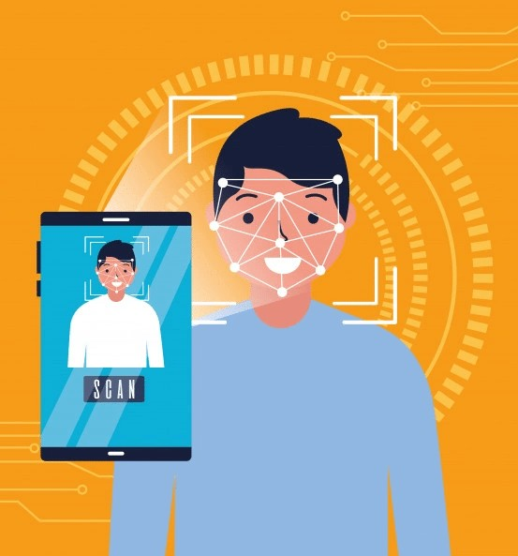
FACE RECOGNITION ATTENDANCE SYSTEM
BY –
MAYANK SRIVASTAVA
PAVAN SINGH

Slide 2
INTRODUCTION
HARDWARE & SOFTWARE
FEATURES
STUDENT
CONCLUSION
F UTURE SCOPE
TABLE OF
CONTENT

Slide 3
MACHINE LEARNING
Machine learning is a branch of AI and computer science which focuses on the use of data and algorithms to imitate the way that humans learn, gradually improving its accuracy.

Slide 4

INTRODUCTION
Every college require an attendance system to maintain record of present student.
Face Recognition Attendance System is developed for the Faculty to maintain attendance record.
It uses facial recognition technology to identify the person’s facial features and automatically mark attendance which is very fast enough than previous method.

Slide 5










SOFTWARE
HARDWARE
Computer (i5, 8gb)
Windows
Camera
Python,MySQL
Hard Disk:- 1TB
Visual Studio Code

Slide 6








CAMERA
ATTENDANCE
STUDENT
DETECTION

Slide 7
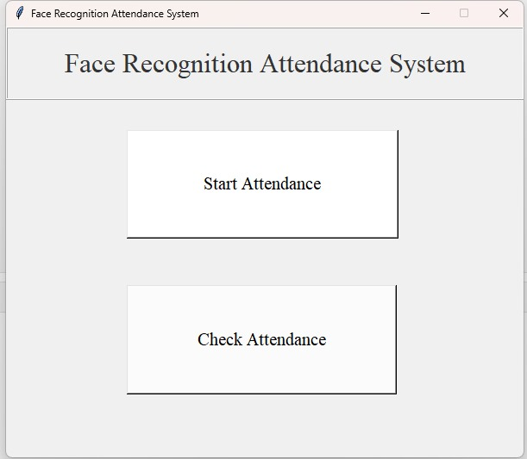
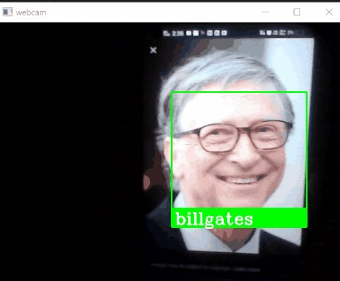
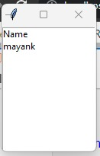
SNAPSHOTS OF PROJECT

Slide 8

CONCLUSION
Before the development of this project. There are many loopholes in the previous method while taking attendance using old method which caused many troubles to most of the institutions.
Therefore, the facial recognition feature method is secure enough, reliable and available for use. It saves time and lot of effort, especially if it is a lecture with huge number of students

Slide 9


FUTURE SCOPE
Some of the future enhancements that can be done to this system are as follows:
Facility of Defaulter list in which system update the defaulter student.
For students, we can develop a dedicated login page in which they can see their details and attendance record
In future we can update the modules like notices for student and many more.

Slide 10

Thank You!

